Slide 1

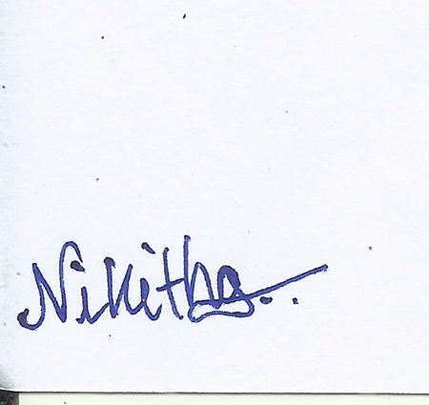
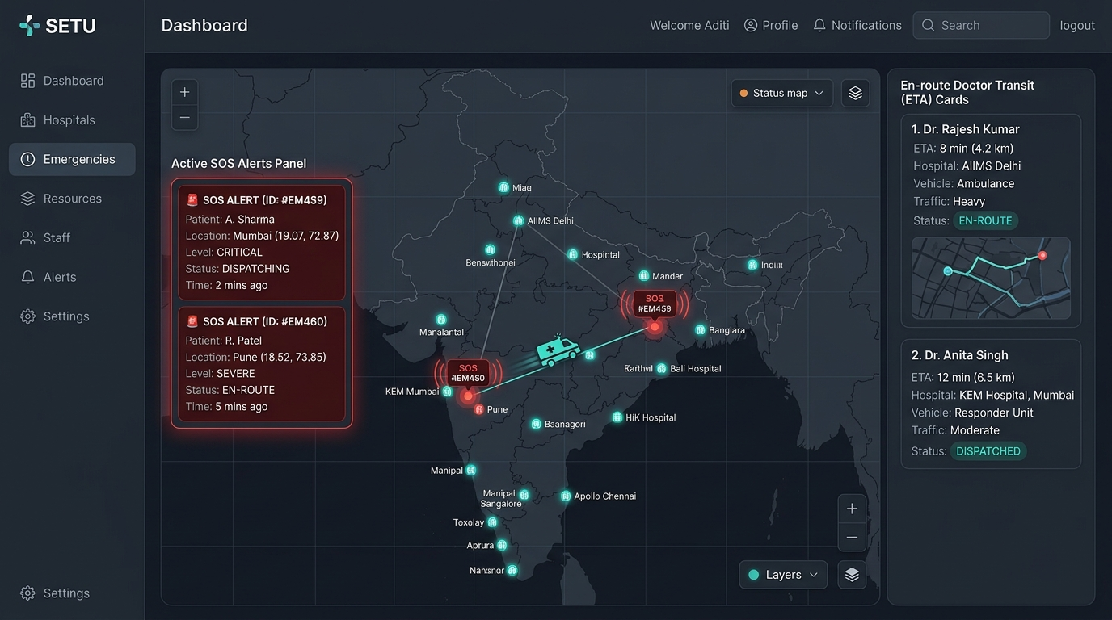
Team Name (Registered on Devfolio): Warriors Theme: Open Innovation
University/Institute name: AMC Engineering College city/state: Bengaluru, Karnataka
Problem Statement Title: SETU – Multi-Hospital Specialist Scheduling & Emergency Dispatch Network
Problem
Emergency coordination in India is severely fragmented. On-call specialist doctors are split across multiple
independent hospitals, leading to manual coordination, schedule conflicts, and response delays of 30-45+ minutes.
Key Challenges
• Manual Outreach: Finding and verifying available specialists via phone calls takes 30+ critical minutes.
• Commute & Schedule Conflicts: Doctors practice across nodes without real-time multi-hospital schedule sync.
Our Solution
SETU (सेतु) bridges independent hospitals into a unified saving-lives grid:
• Unified Scheduler: Consolidates clinician availability across all affiliated network nodes.
• AI Match Engine: Instantly ranks & pages specialists based on proximity, availability, and commute ETAs.
• Live Commute Map: Real-time route tracking and auto coordinate-based check-in status sync.
• Trust Ledger: Cryptographically logs response times and clinician metrics under DPDP act compliance.
• Global Patient Handoff: Compiles secure clinical notes broadcasted instantly to patient records.

Slide 2
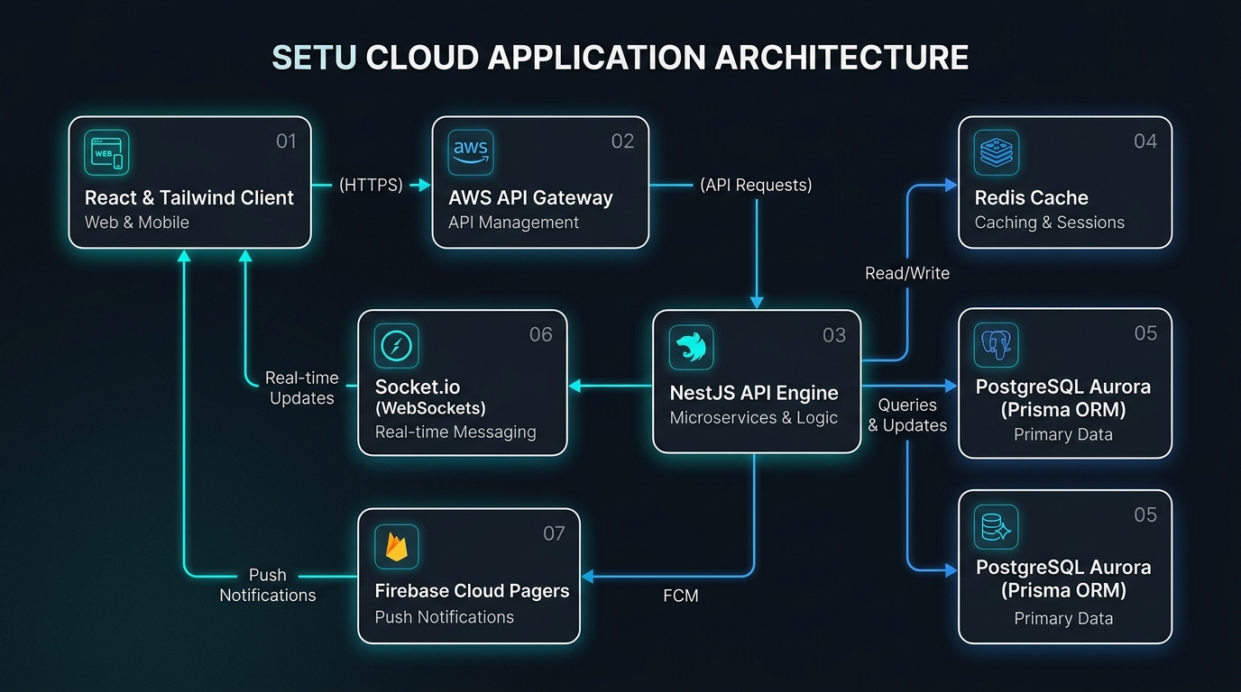
TECHNICAL APPROACH
Frontend
React.js + Tailwind CSS + Vite
Backend
NestJS Framework (TypeScript)
Database
PostgreSQL (Prisma ORM)
AI/NLP
Priority Match Engine (Proximity & Occupancy)
Socket.io (WebSockets) Real-time Sync
Additional
Firebase Cloud Messaging (Pagers)
JWT Authentication & AWS API Gateway
Redis Caching & Cryptographic Audit Trails
@DevHack Idea submission- Template
3

Slide 3

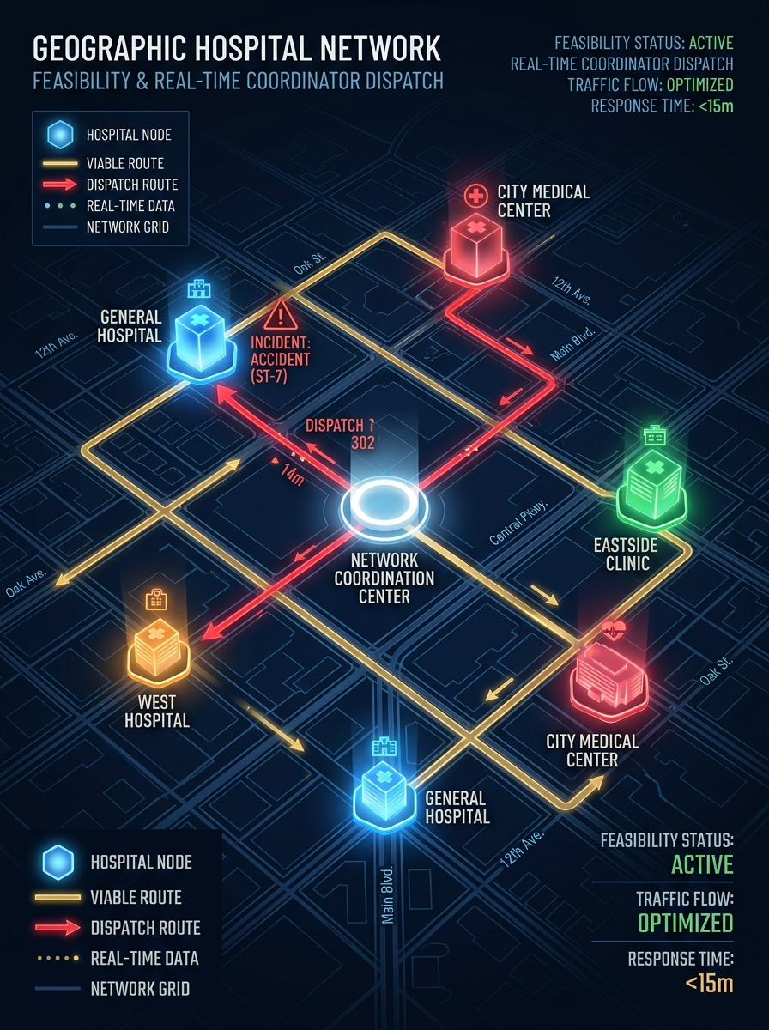
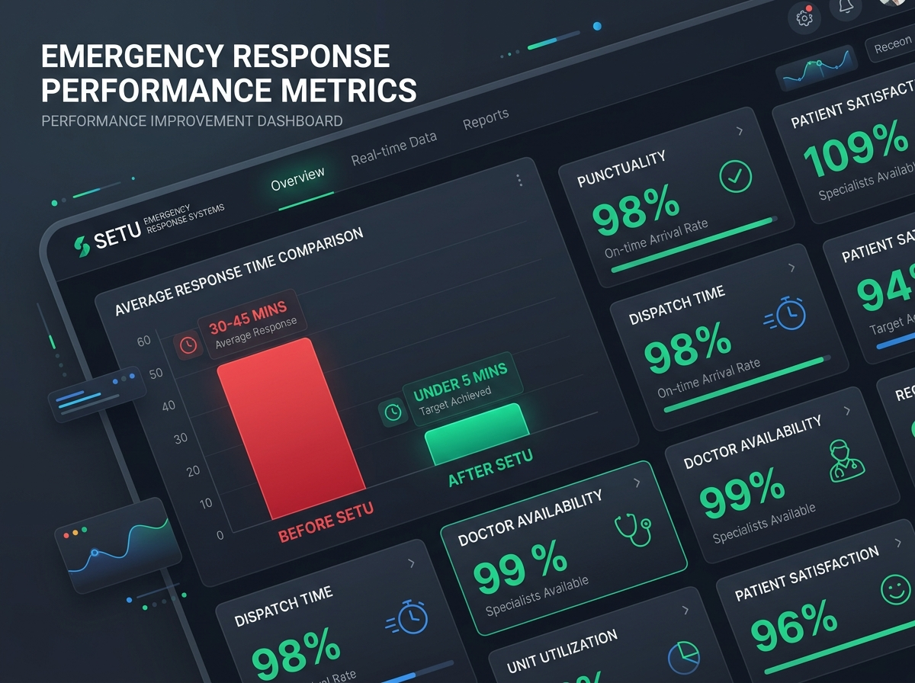
Team Warriors
FEASIBILITY AND IMPACT
Multi-hospital node routing proves city-wide cluster feasibility, while automated AI dispatch reduces critical emergency
response times by 88% (from 45 minutes down to under 5 minutes), saving lives during the golden hour.
@DevHack Idea submission- Template
4

